Slide 1

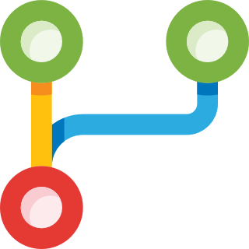
Forking

Slide 2

openapp

Slide 3


openapp
myopenapp

Slide 4
openapp
origin
myopenapp

Slide 5
upstream
openapp
origin
myopenapp

Slide 6

upstream
openapp
origin
myopenapp

Slide 7

upstream
openapp
origin
myopenapp

Slide 8
upstream
openapp
origin
myopenapp

Slide 9

upstream
openapp
origin
myopenapp

Slide 10

Allows anyone to contribute to the project, without write access.
Freely experiment with changes without affecting the original project.
Use someone else's project as a starting point for your own idea.
No need to wait for write access.

Slide 11


